Slide 1


Predicting Diabetes
Nekeitrius Davis

Slide 2
Diabetes
More than 37 million people in the United States have diabetes.
96 million adults in the United States have prediabetes.
Diabetes is the 7th leading cause of death in the United States.

Slide 3
Goal :
Train a model that predicts diabetes in an individual.

Slide 4
Diabetes, Hypertension and Stroke Prediction Data Set

Slide 5
Data Set Features :
Age
Sex
HighChol
CholCheck
BMI
Smoker
HeartDiseaseorAttack
PhysActivity
Fruits
Veggies
HvyAlcoholConsump
GenHlth
MentHlth
PhysHlth
DiffWalk
Diabetes
Hypertension
Stroke

Slide 6
Understanding Data
18 columns
70,692 rows
All non-null
Floats

Slide 7
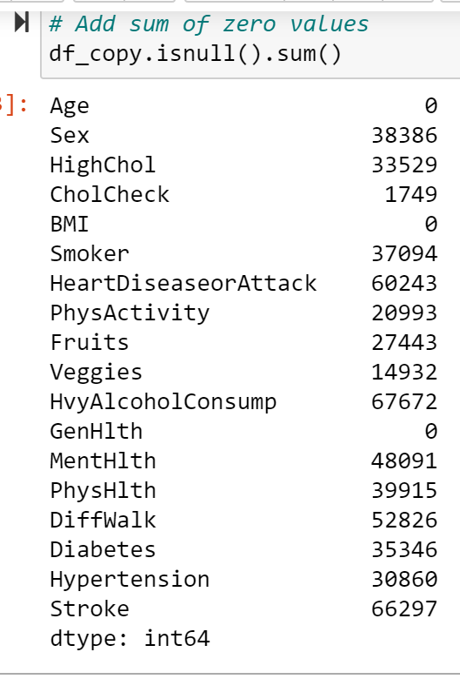

Understanding Data: All Non Null

Slide 8
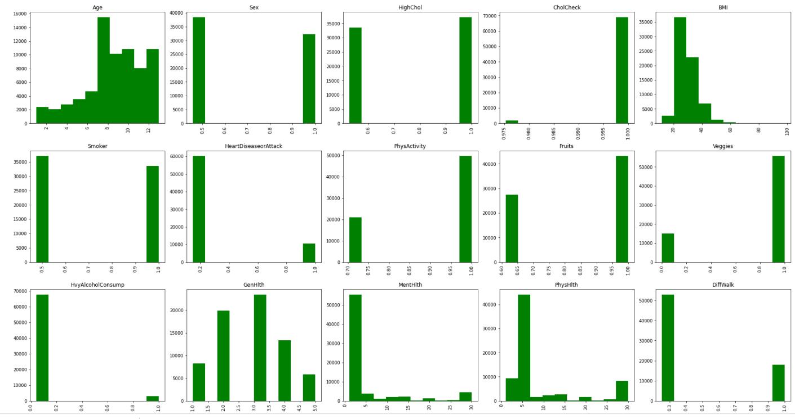
Data Understanding: Frequencies

Slide 9
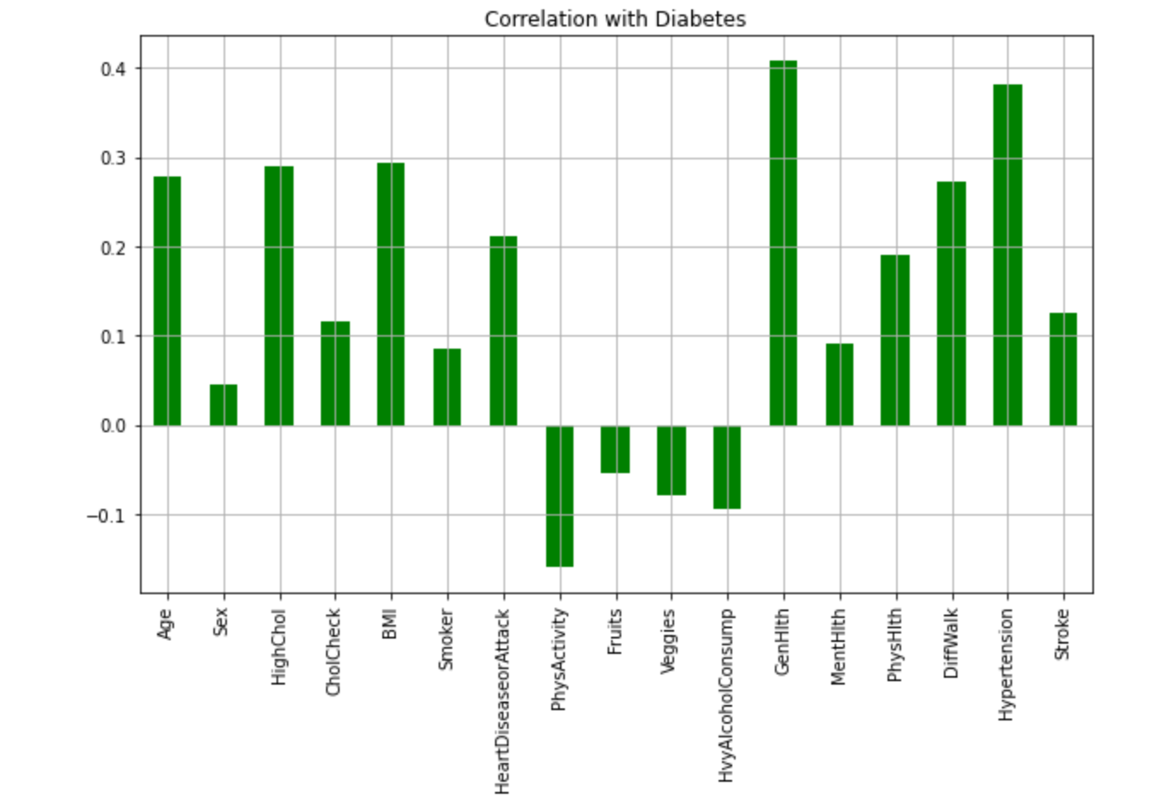
Data Understanding: Correlation

Slide 10
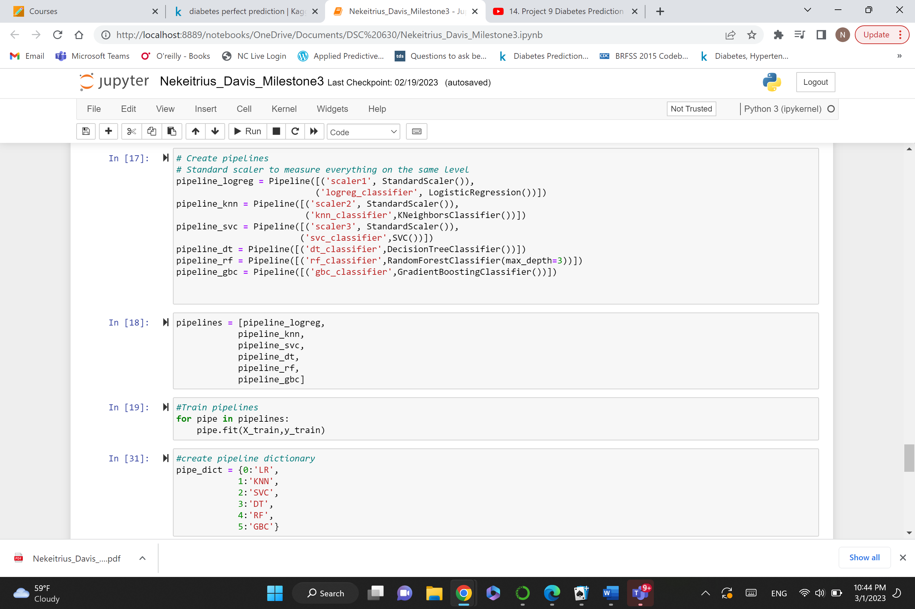
Pipelines

Slide 11
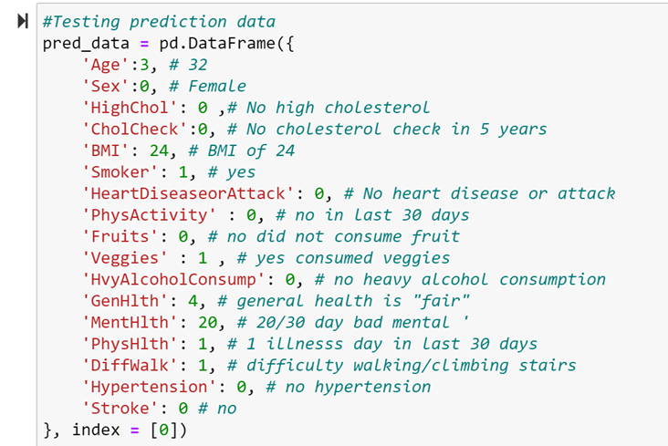
Prediction Data

Slide 12
Conclusion

Slide 13
Sources
Frengzkermova, K. (2022, December 3). Diabetes prediction. Kaggle. Retrieved January 26, 2023, from https://www.kaggle.com/code/frengzkermova/diabetes-prediction
Center for Disease Control . (2016, August 23). Behavioral Risk Factor Surveillance System. Retrieved January 27, 2023, from https://www.cdc.gov/brfss/annual_data/2015/pdf/codebook15_llcp.pdf
Centers for Disease Control and Prevention. (2022, June 3). Assessing your weight. Centers for Disease Control and Prevention. Retrieved January 26, 2023, from https://www.cdc.gov/healthyweight/assessing/index.html
Centers for Disease Control and Prevention. (2022, September 30). Diabetes Quick Facts. Centers for Disease Control and Prevention. Retrieved February 1, 2023, from https://www.cdc.gov/diabetes/basics/quick-facts.html
Centers for Disease Control and Prevention. (2022, September 30). Risk factors for diabetes-related complications. Centers for Disease Control and Prevention. Retrieved February 1, 2023, from https://www.cdc.gov/diabetes/data/statistics-report/risks-complications.html

